Slide 1

An Automated COVID-19 SOPs Monitoring And Management System
GSN: FALL 21-18
Presented by:
Maaheen Yasin (L18-1267)
Inbisat Mudassar Dar (L18-1283)
Ahmad Tameem Kamal (L18-1358)
Advisor: Mr. Hamza Yousuf
Client: Dr. Omer Saleem
Evaluation Committee:
Ms. Shazia Haque
Dr. Omer Saleem

Slide 2
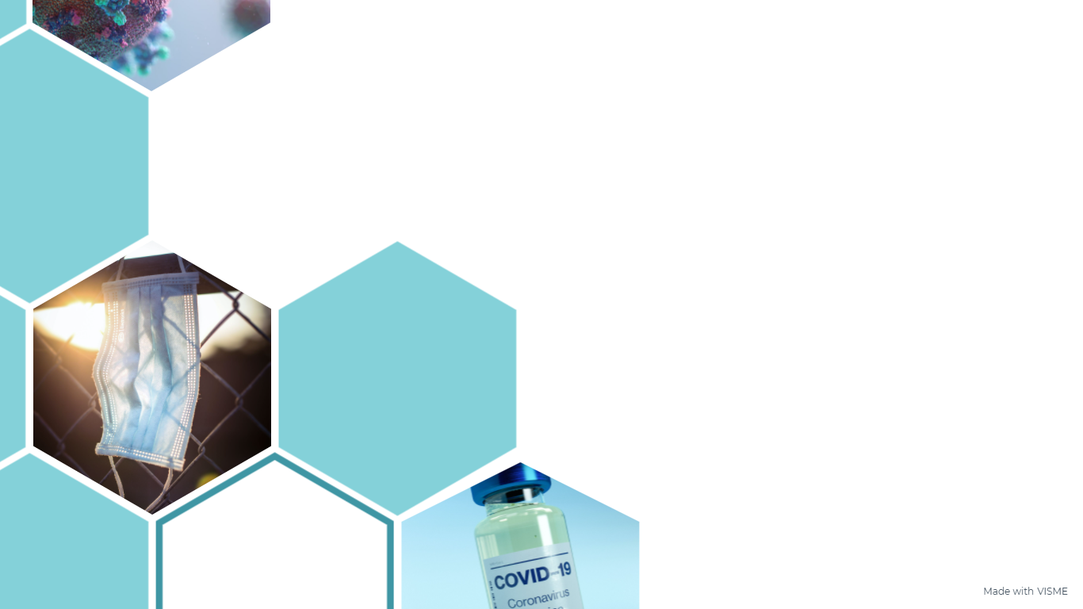
CONTENTS
Computer Vision
Machine Learning vs Deep Learning
Different Deep Learning Algorithms
How is Social Distancing monitored?

Slide 3
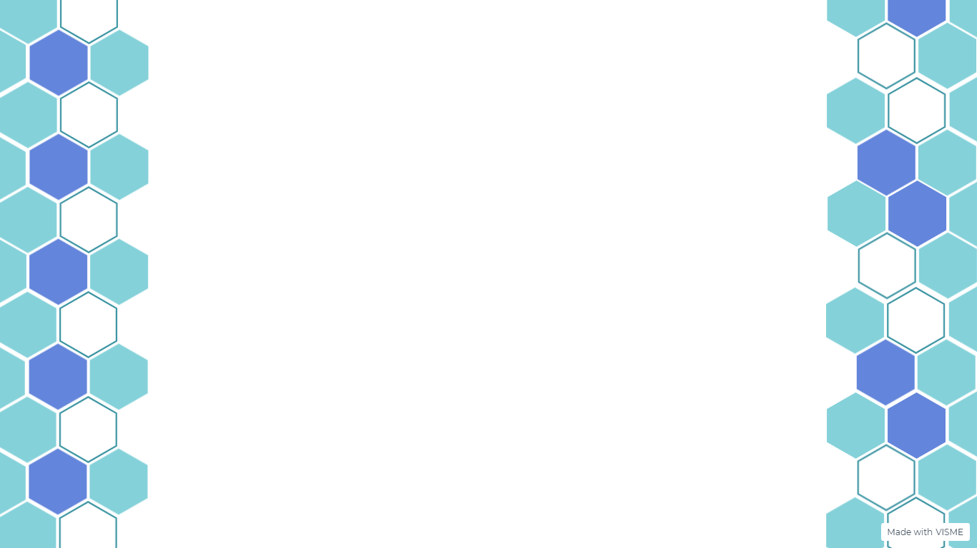
Computer Vision
Computer Vision is the Artificial Intelligence field, which enables the computer to see, observe and understand through input images or video
Object Detection, Image Classification, Image Captioning, Image Reconstruction, Object Recognition
Deep learning and convolutional neural network (CNN)
Computer Vision also uses image processing

Slide 4
Machine Learning vs Deep Learning
Machine Learning: Computer itself thinks and less human intervention required. The algorithms used in machine learning are regression algorithms or decision trees, for example
SIFT
Support Vector Machine
Viola Jones Algorithm
Deep Learning: It is the subset of Machine Learning. Computer learning on the basis of structure modeled on human brain such as neural networks.
Artificial Neural Networks (ANN)
Faster R-CNN
YOLO Algorithm

Slide 5
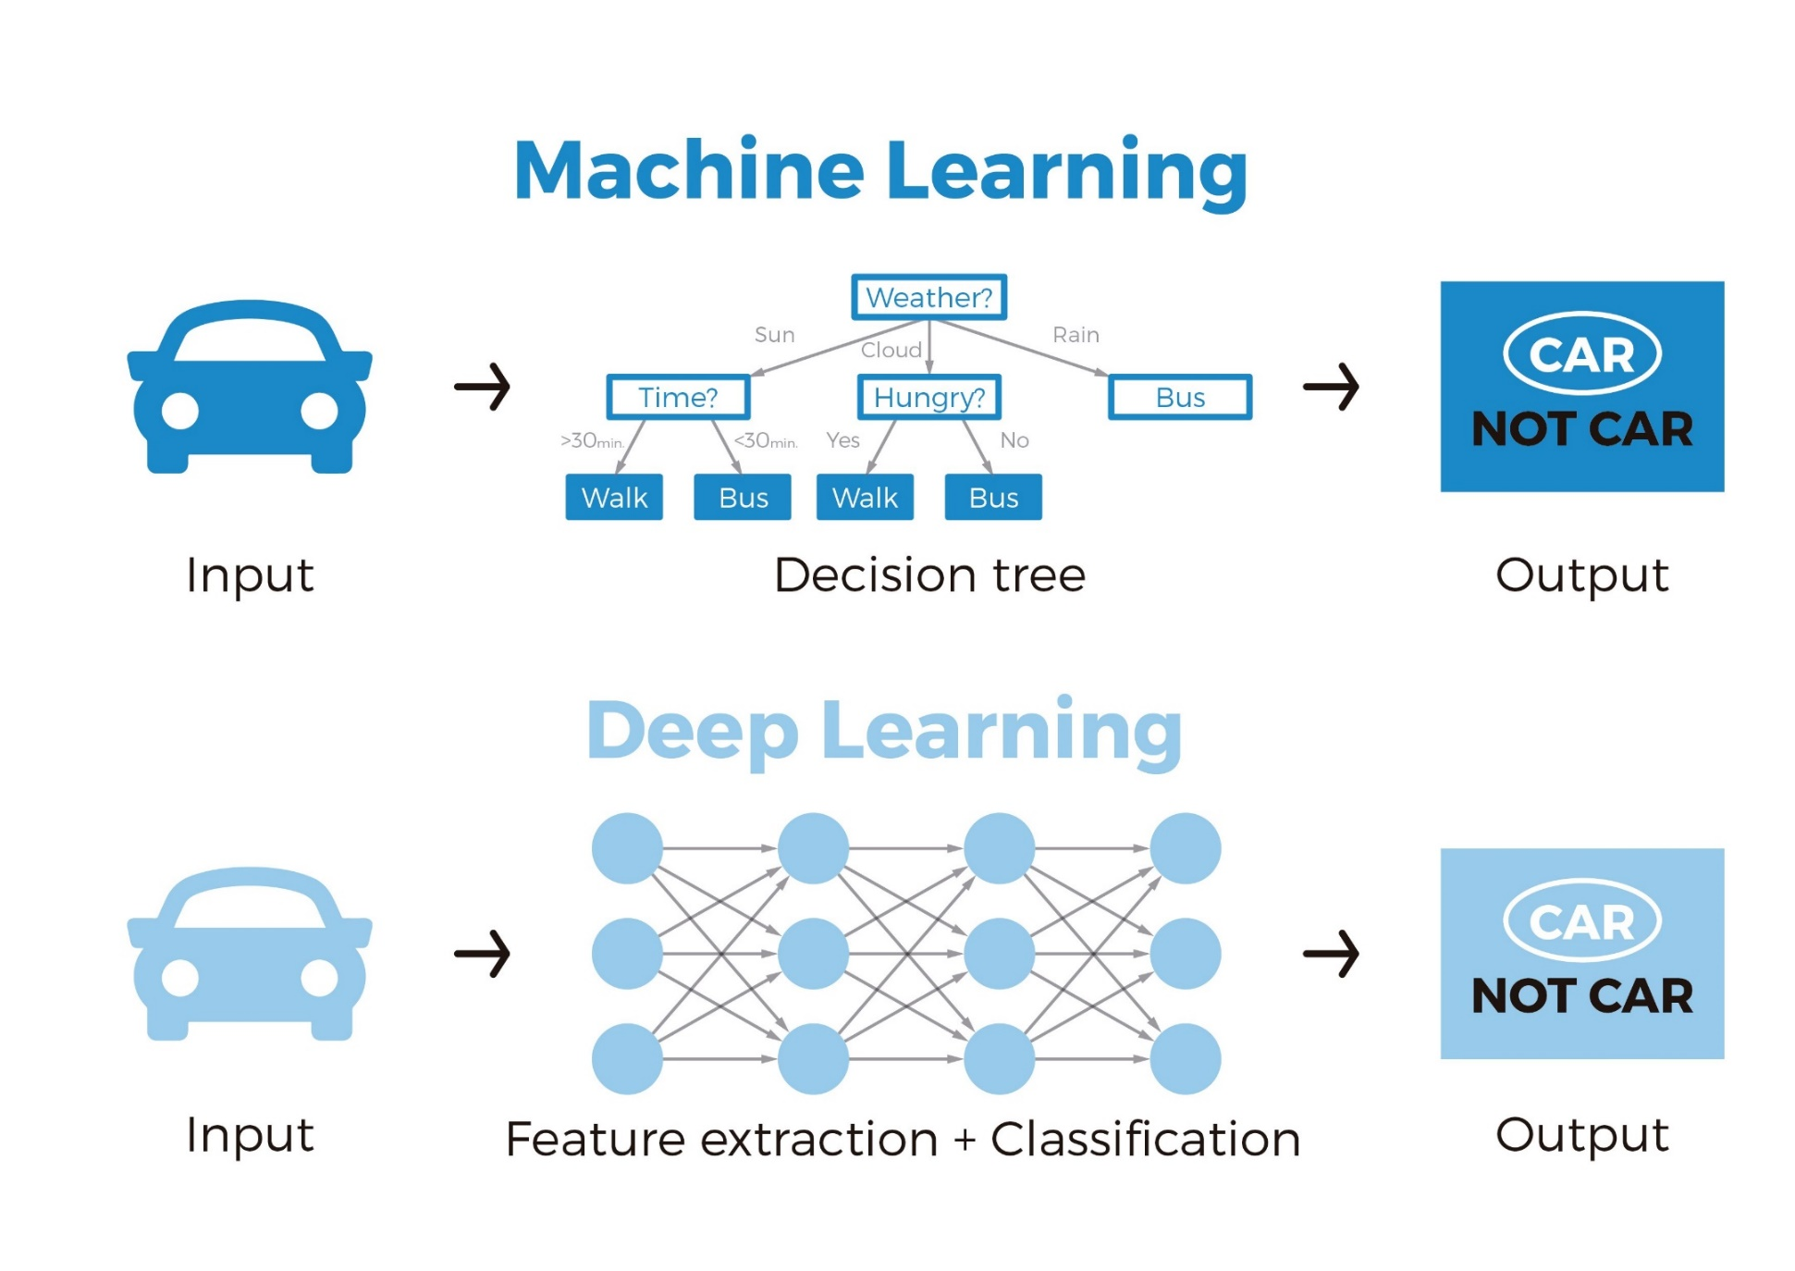
Machine Learning vs Deep Learning

Slide 6
Haar Cascade Algorithm
Also know as Viola-Jones Algorithm, Haar Cascade is the first ever real time object detection framework publish in 2001
Based on machine learning approach and uses the sliding window
Training is done with positive and negative images
Detection using haar-like features
It is still very fast as compare to recent algorithms. Real time detection is possible and openCV version is compatible with embedded systems such as raspberry pi
This algorithm is not accurate and false detections are common.

Slide 7
R-CNN Algorithms
RCNN, Fast RCNN, Faster RCNN, Mask RCNN
Region Convolutional Neural Network and Two stage Model
Uses the regional proposal structure
The standard RCNN uses selective search to extract almost 2000 region of interests and applying CNN on these regions. Faster RCNN used the prediction to extract reasons instead of selective search
Very accurate and efficient but not recommended for mobile or embedded devices

Slide 8
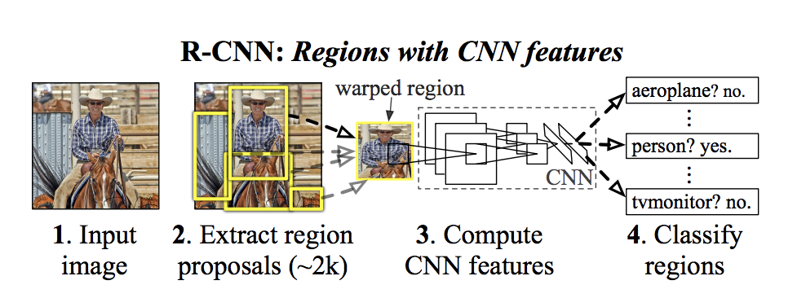
R-CNN Algorithms

Slide 9
Single Shot Detection (SSD)
Introduce by Liu at al in 2015 paper, SSD: Single Shot Multi-Box Detector
Originally VGG16 CNN model is used but currently commonly used CNN models are ResNet and MobileNet
Both localization and detection are perform in single shot, and similar to YOLO it look image only once
Super Real Time Performance with average 60 FPS, that is why it is widely used in self driving vehicles
SSD with MobileNet is lightweight algorithm as compare to other detection algorithms so it can be used in embedded systems and mobile computers such as Raspberry Pi
Not good for detecting small objects

Slide 10
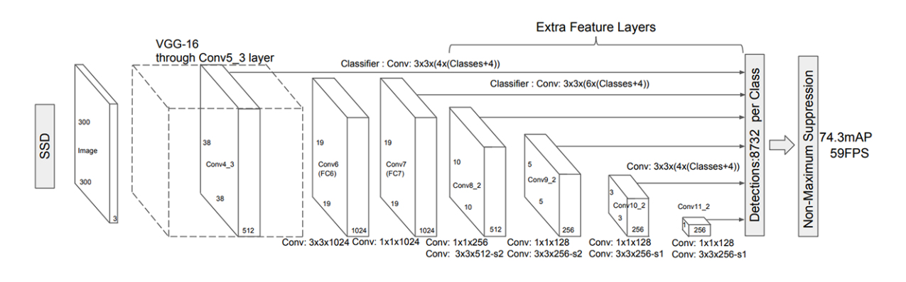
Single Shot Detection (SSD)

Slide 11
Retina-Net
One Stage Object Detection Model
Uses CNN architecture
Real Time, dense and small scale objects detection
Widely used in satellite and aerial imagery
Speed and performance is better as compare to the SSD, DSSD, R-FCN, and FPN but accuracy is less than R-CNN.
Compatible for mobile and embedded systems

Slide 12
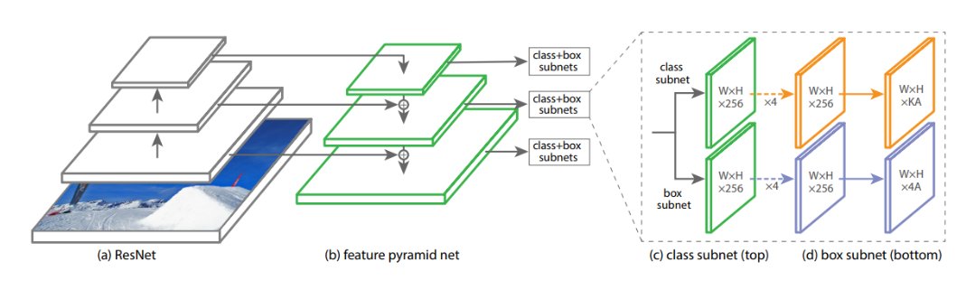
Retina-Net

Slide 13
You Only See Once (YOLO) Algorithm
Apply CNN on complete image for detection instead of specific regions
Uses CNN architecture and also unifies object detection and classification. YOLOv3 uses DarkNet-53 CNN which has two stack of 53 convolution layers
It predict the 10647 bounding boxes for each image and finalize the highest score boxes for each object class
One of the most accurate and fastest detection algorithm. YOLOv4 has 65 FPS average detection speed
Required GPU for proper real time detection
Struggles with small object detection. Also algorithm is not designed for embedded systems and require GPU for proper real time detection

Slide 14
TinyYOLO
Modified YOLO specifically designed for low performance or mobile systems with no dedicated GPUs
Average FPS is 244 on high end systems, but in 32-bit computer such as raspberry pi it reduced to 4 FPS
Average Precision is 23.7% mAP which is 50% less as compare to standard YOLO algorithm
It required high specs embedded system such as raspberry pi model 4 with 4GB ram and TPU USB accelerator (mini GPU) for real time detection

Slide 15
YOLOR
YOLOR stands for You Only Learn One Representation
Uses CNN approach with multi-task learning
It is different from YOLO and uses different architecture and model
The algorithm is designed recently and published in 2021
This algorithm introduces the efficient method for object detection by integrating explicit knowledge from data and inputs with implicit knowledge
Against YOLOv4 it is 88% faster and +3.8% average precision
Still in introductory level and not widely implemented

Slide 16
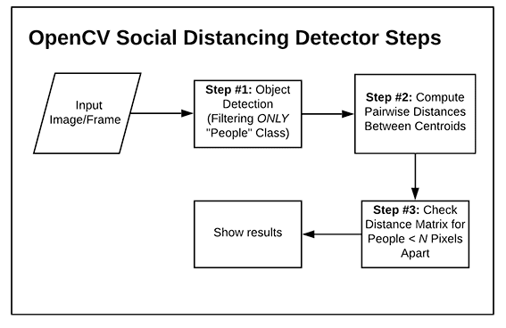
How Social Distancing is Monitored?

Slide 17
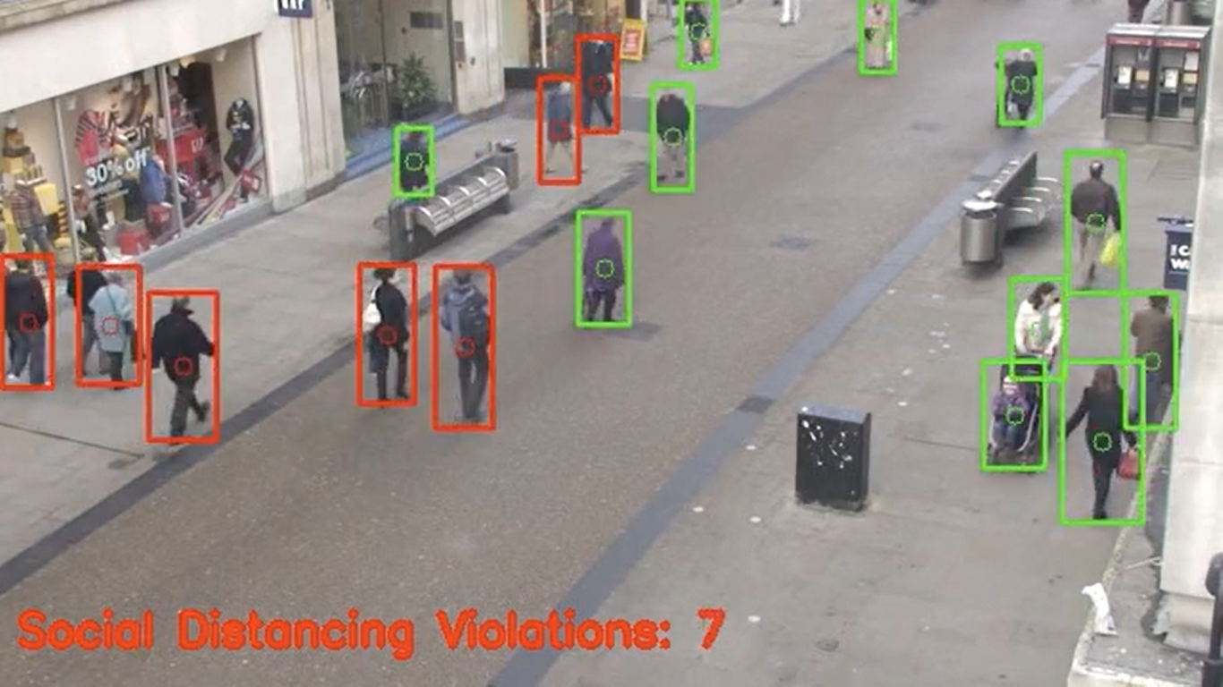
Social Distancing

Slide 18


